Slide 1
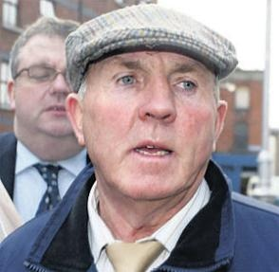
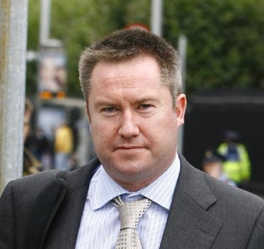
Who they are?
What the connection with Bulgaria is?

Slide 2
Thomas “Slab” Murphy, allegedly the chief of staff of the Provisional IRA.
Mickael Thomas Lynn,
an Irish lower, who ran up business debts of
up to 130 m euro

Slide 3
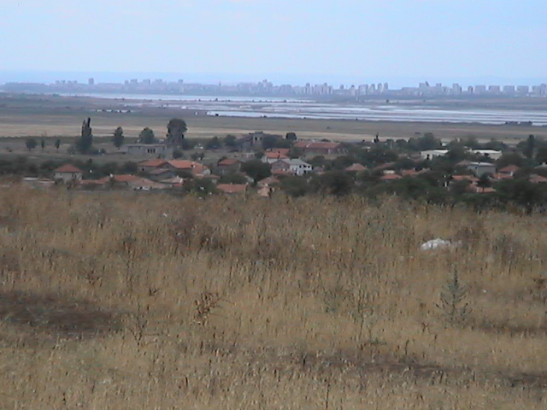
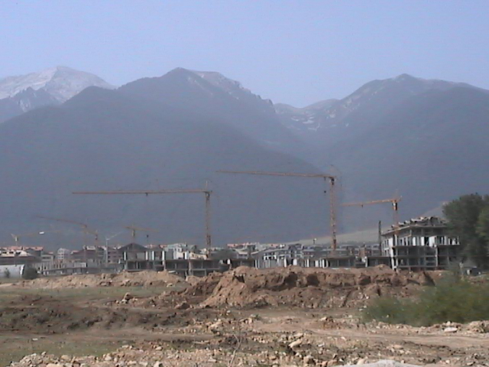
July 2007: Land on the Black Sea coast and around Bulgaria’s biggest ski resort now belongs to the nephews of Thomas “Slab” Murphy

Slide 4
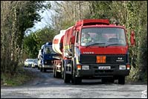
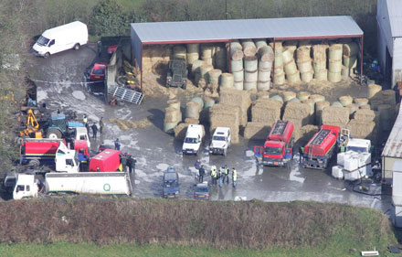
In October 2005, officers of the British Assets Recovery Agency (ARA) and the Irish Criminal Assets Bureau (CAB) raided a number of Murphy family businesses and the High Court granted the ARA the right to freeze nine family properties worth more than 1.5 million pounds.

Slide 5
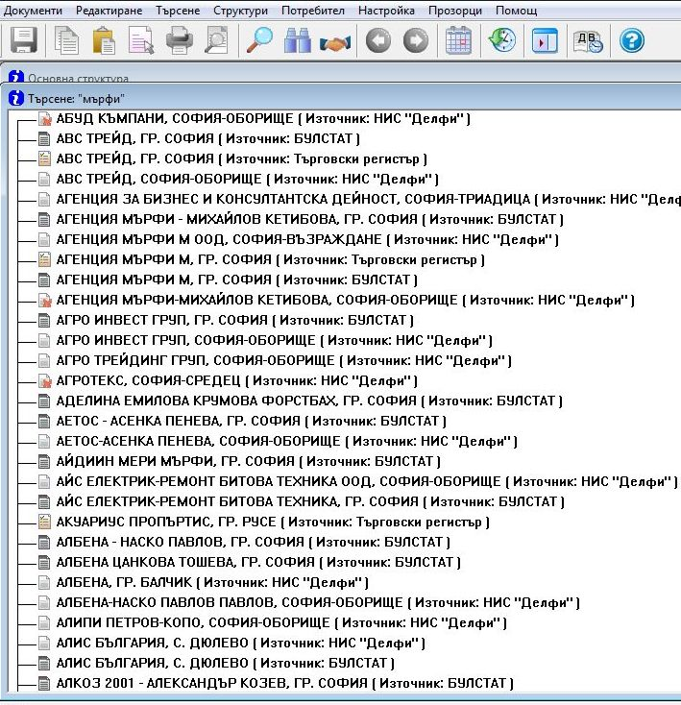
Almost 900 companies in Bulgaria with participation of someone Murphy

Slide 6
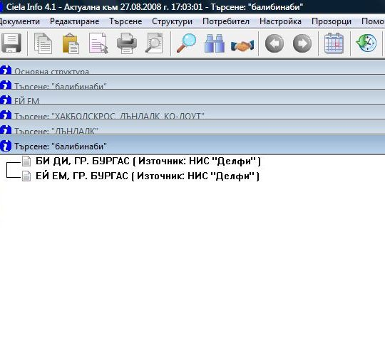
Only two companies with Murphy from Balibinaby

Slide 7
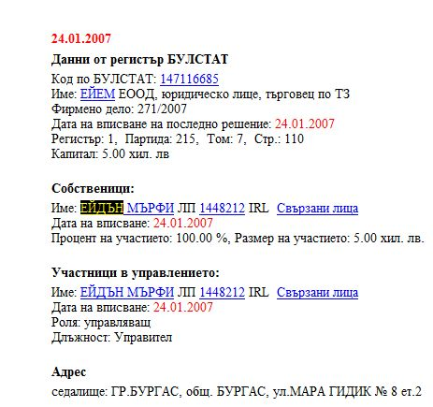
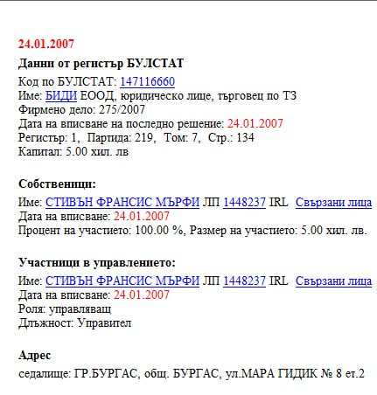
Aiden and Stephen Murphy, sons of Murphy’s two brothers, in January 2007, registered companies they called "A. M." and "B. D." with the same Burgas address of 8 Mara Gidik Street.

Slide 8
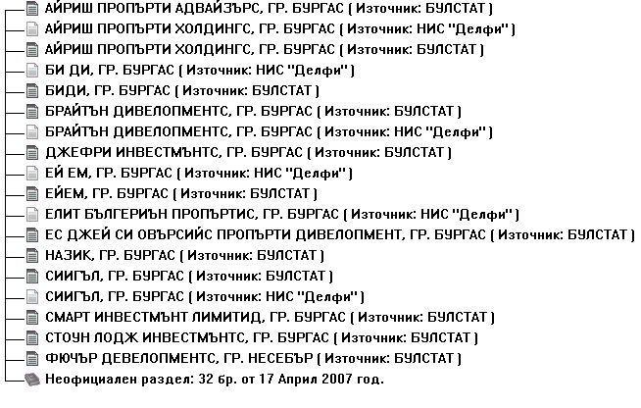
A new company owned by Martin and Paul Kirk, two more nephews of Thomas Murphy, the sons of his sister Ann.

Slide 9
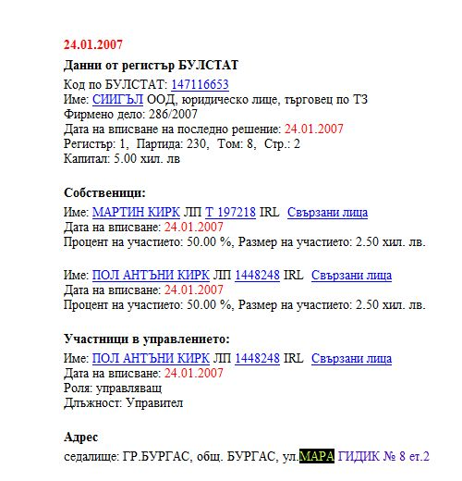
The Kirk brothers set up Seagle the same day their cousins were registering their firms and they used the same trading address in Burgas of 8 Mara Gidik Street.

Slide 10
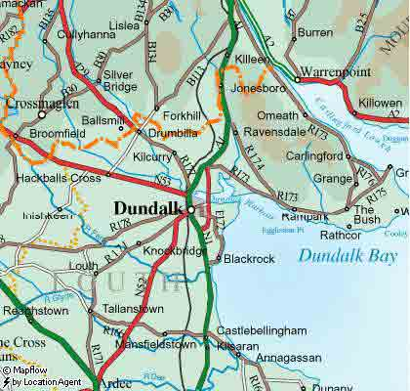
The cousins both listed as their home address their uncle’s farm in the village of Ballybinaby, Hackballs Cross, in northeast Ireland’s County Louth.

Slide 11
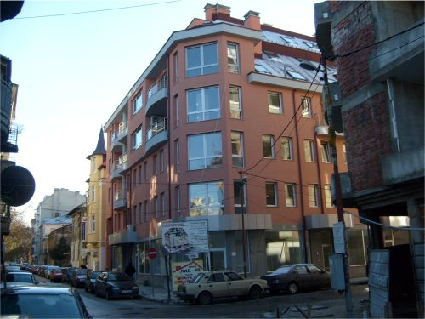
Stephen Murphy bought an apartment in the capital Sofia

Slide 12
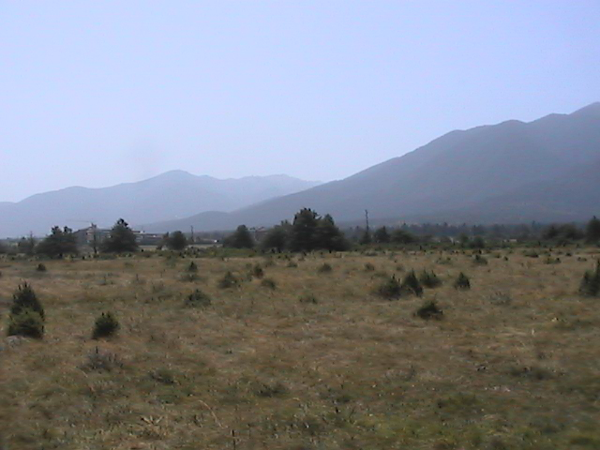
In March of last year, Aiden Murphy’s A.M. company bought another 4,000 square meters of land for 150,000 Euros near Kukurevo, a rapidly development area housing the largest ski resort east of the Alps.

Slide 13
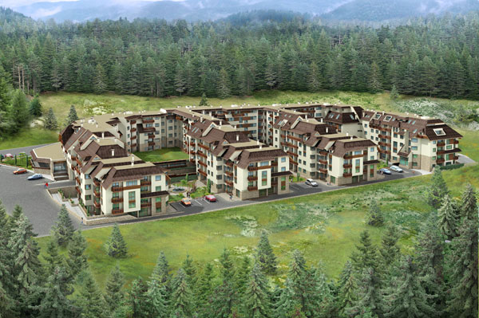
Kendar All Seasons, a 50 m euro project of Mickael Linn, is located in the same area, near to town of Razlog

Slide 14
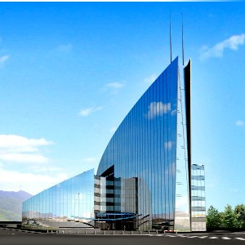
Lynn’s office and the office of Murphy’s lowers in Sofia are door to door in one and the same building

Slide 15
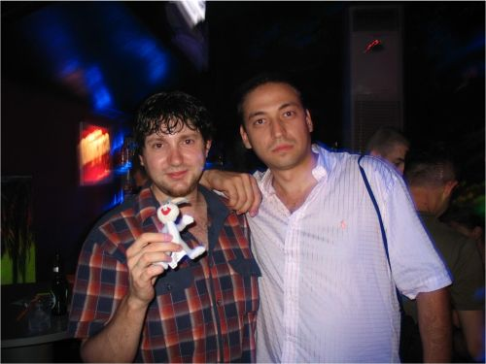
“Yeah, it’s true, we registered the companies,” said Philip Chikov (right), an owner of C&I Legal Partners in Bugas, when asked about A.M. and B.D.

Slide 16
Are they connected?
We are still waiting for the answer

Slide 17
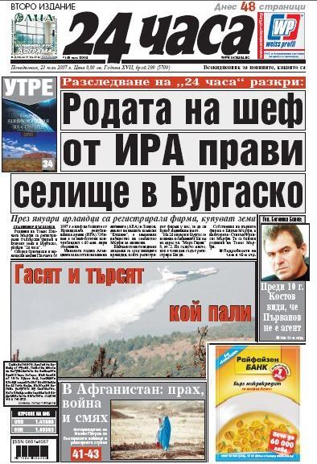
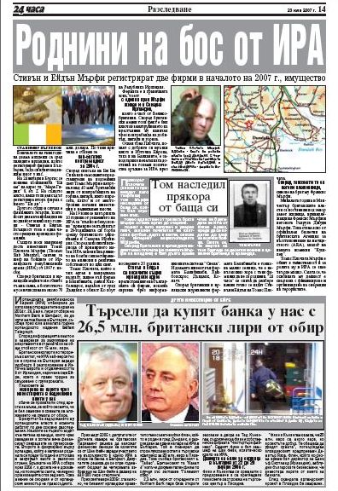
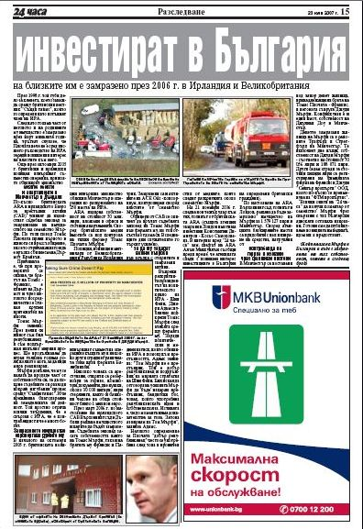
July, 2007

Slide 18
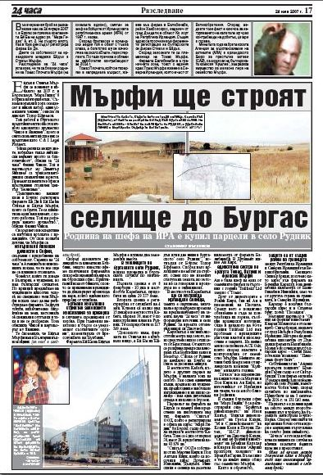
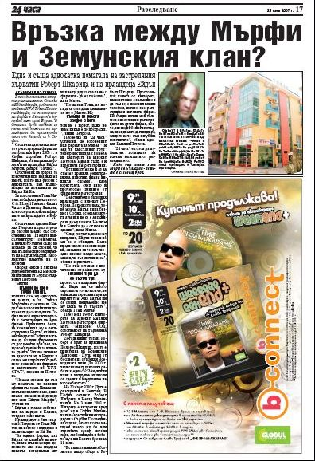

Slide 19
