Slide 1
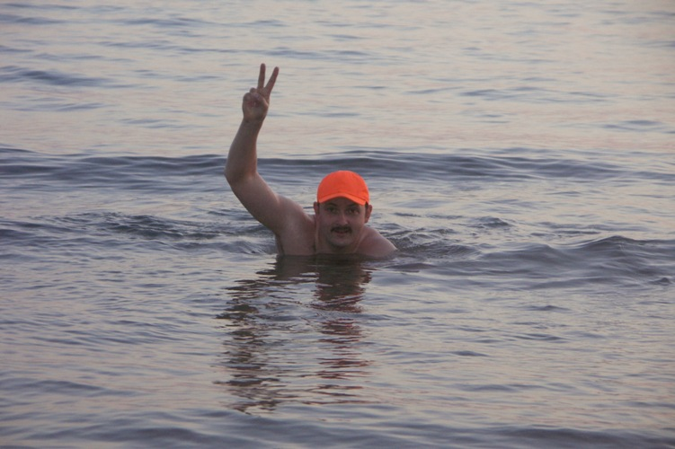
Evgeny
Titov
estitov@mail.ru
Russia
Krasnodar city
“Novaya Gazeta” newspaper

Slide 2
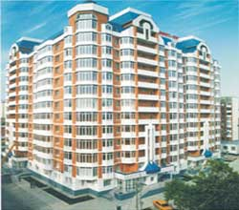
protected house near the yard
of Kuban vice-governor Remezkoff
it was necessary to go there
to get certificate, confirm your accessory to authority is the only way

Slide 3
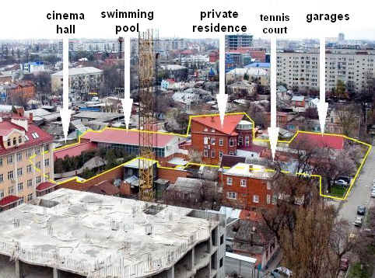
General photo of
vice-governor’s yard

Slide 4
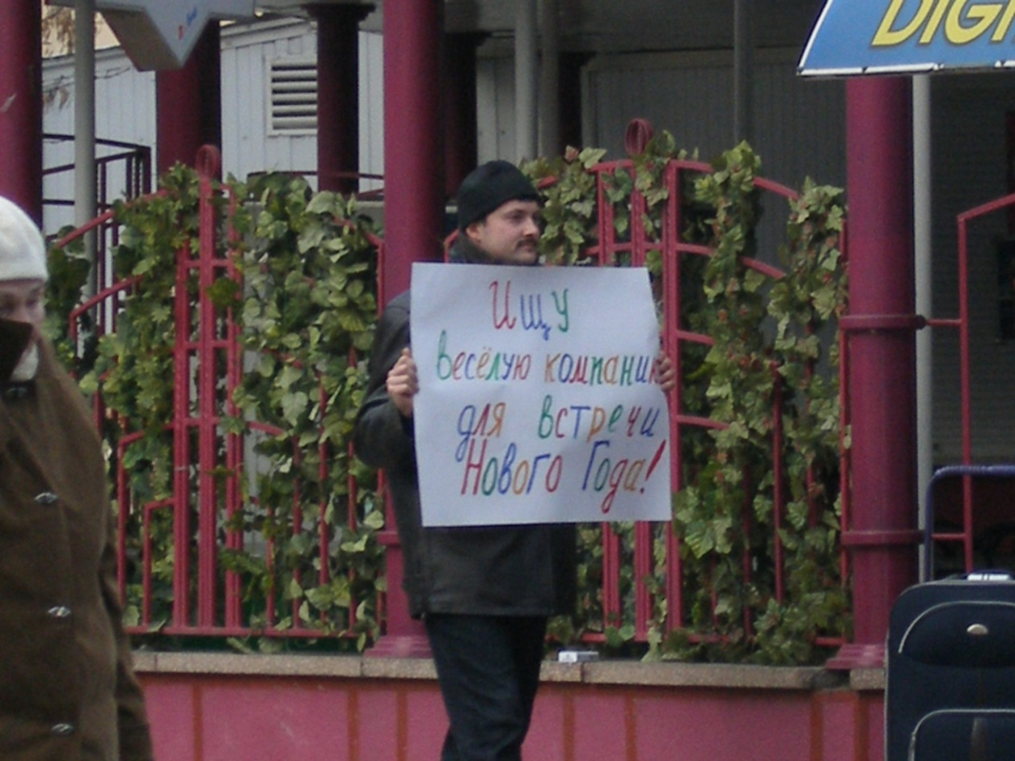
I’m with poster
(hidden camera)
my goal is to meet any patient of psychiatric hospital

Slide 5
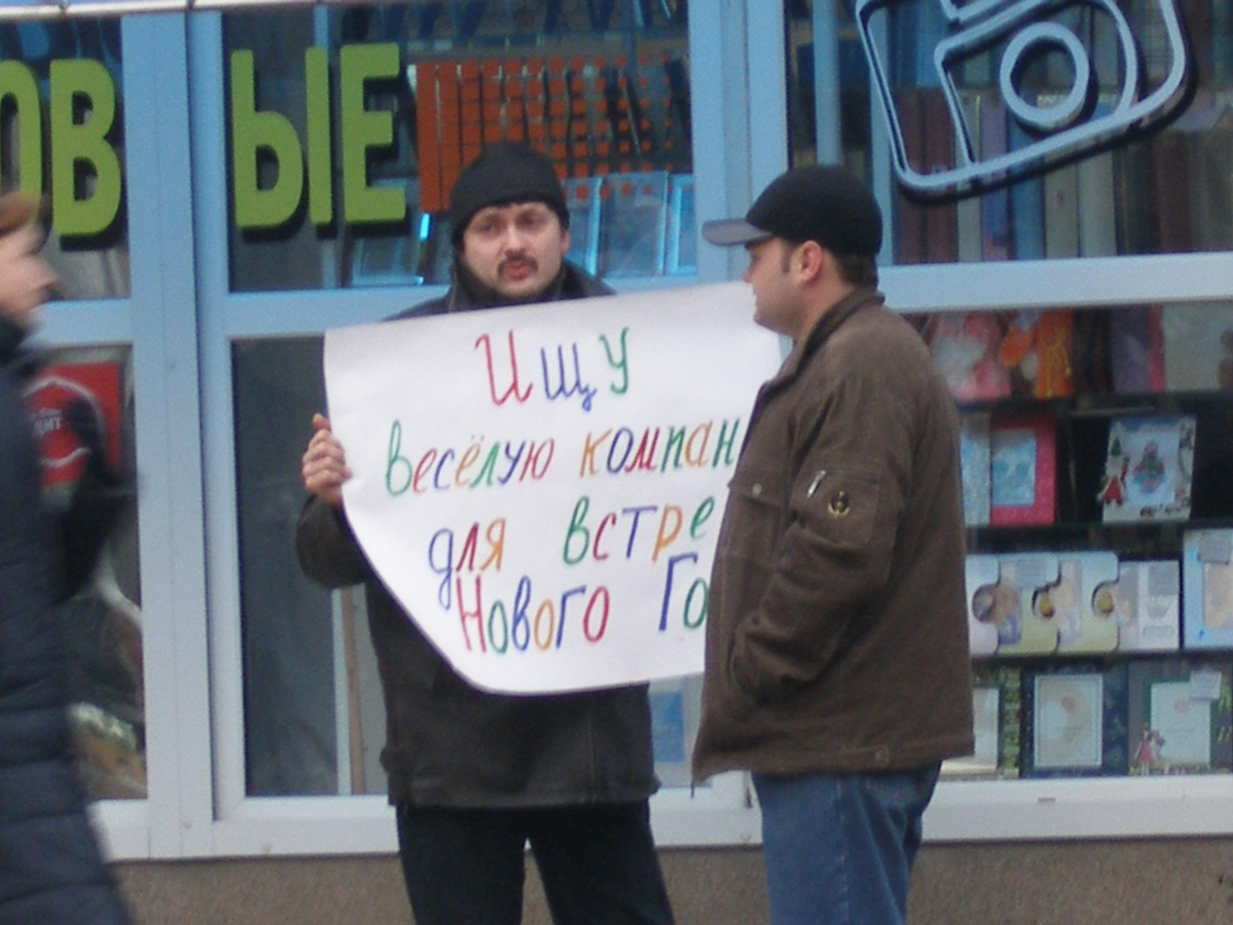
I’v met psychiatric hospital patient
(hidden camera)

Slide 6
contact Evgeny Titov
Russia, Krasnodar, “Novaya Gazeta”
mob. +7 928 255 25 35
E-mail: estitov@mail.ru
www.novayagazeta.ru

